Slide 1

Craft n’ Creations- Craftiness is Happiness
CMS Final Presentation
By Fardina Kabir
1910080005

Slide 2
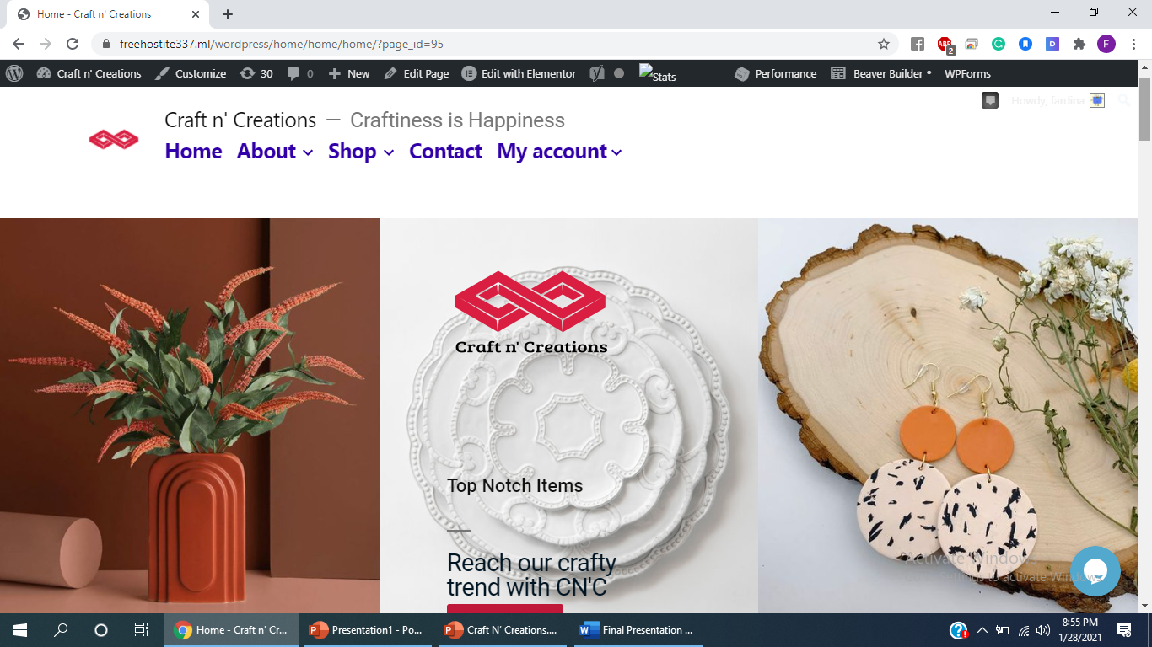
About the website: It’s an e-commerce website for the selling of handmade artifacts. Home page:

Slide 3
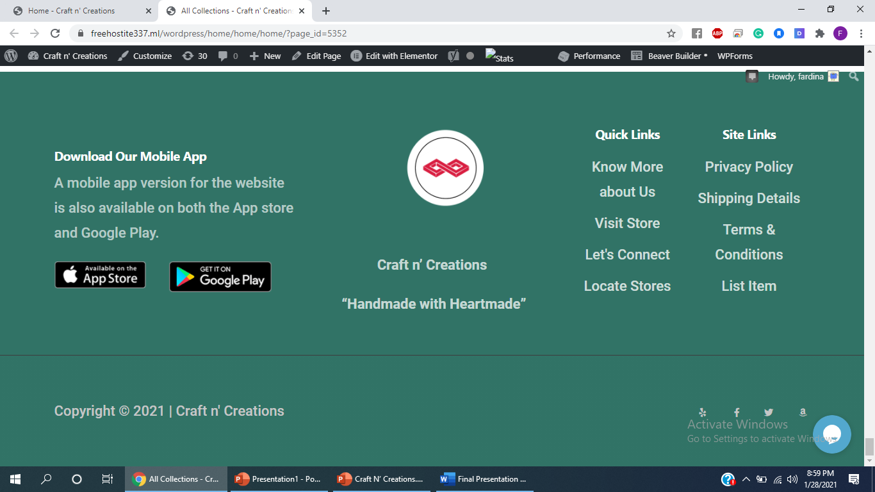
Footer with Elementor:

Slide 4
Creation of Menus with wordpress only
4) Contact
5) My account:
My account
Cart
Wishlist
There are 5 menus:
1)Home
2)About
3) Shop:
All Collections
Christmas Sales
Face Masks
Personalized Gifts
Stockings
Ceramic cute pieces
Earrings
Ceramic & Clay Earrings
vase & crockery.

Slide 5
Use of Widgets with Elementor :
1.Shortcode
2. Inner Section
3.Button
4. Video
5. Rating
6. Flip Box
7. Image Gallery
8. Icon List
9. Title
10. Text Editor
11. Testimonial
12. Image Box
13. Image

Slide 6
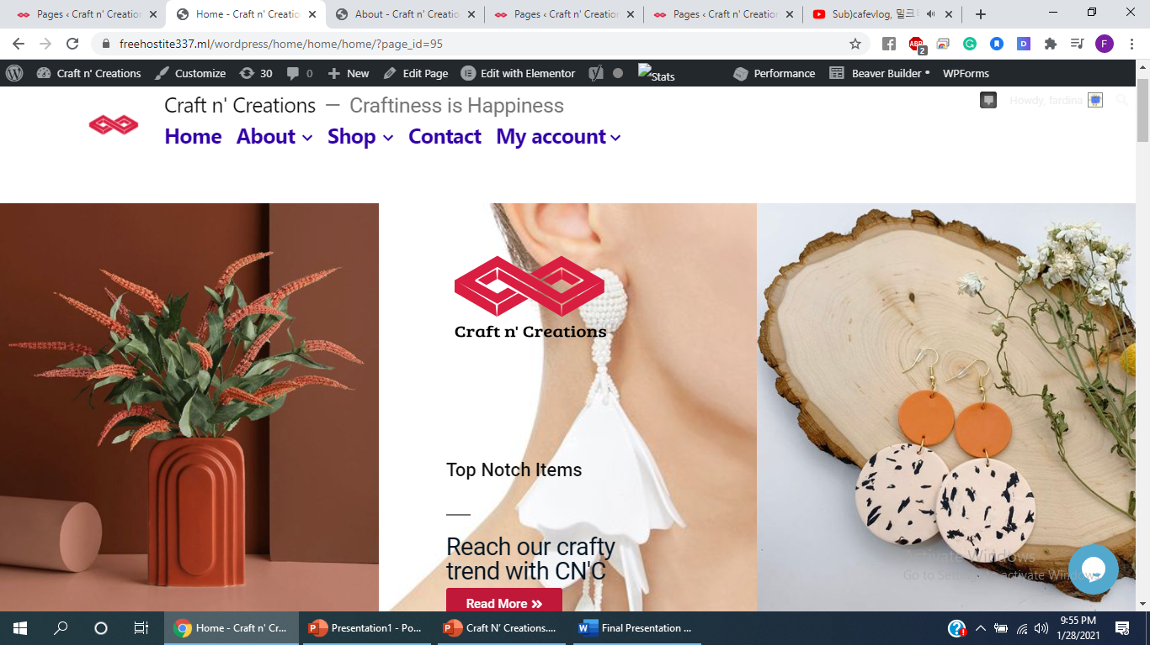
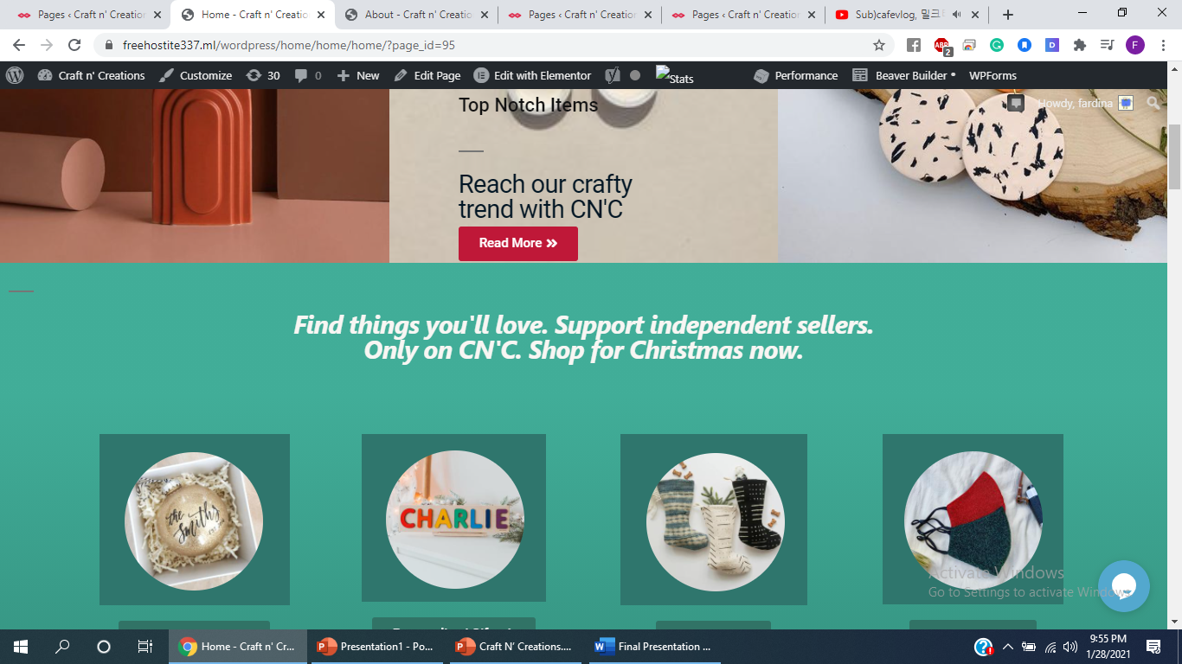
More than five different kind of post blocks used:

Slide 7
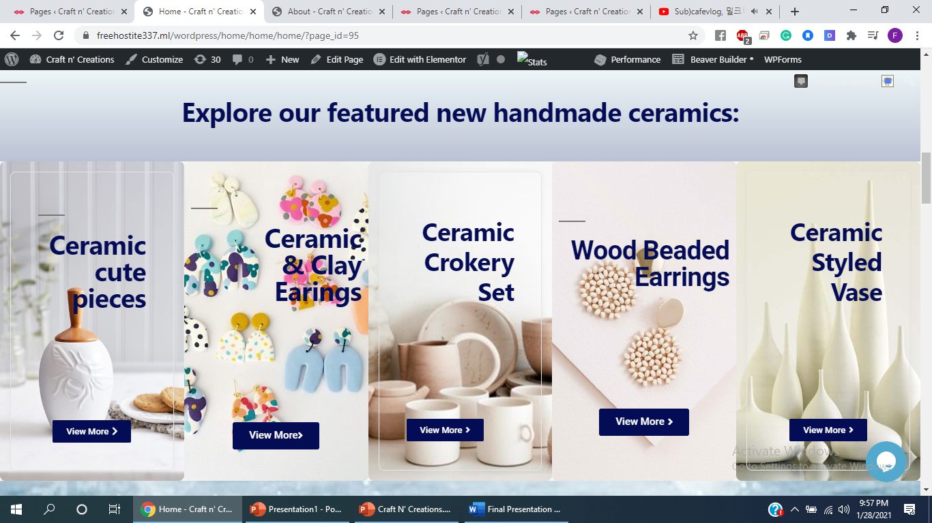
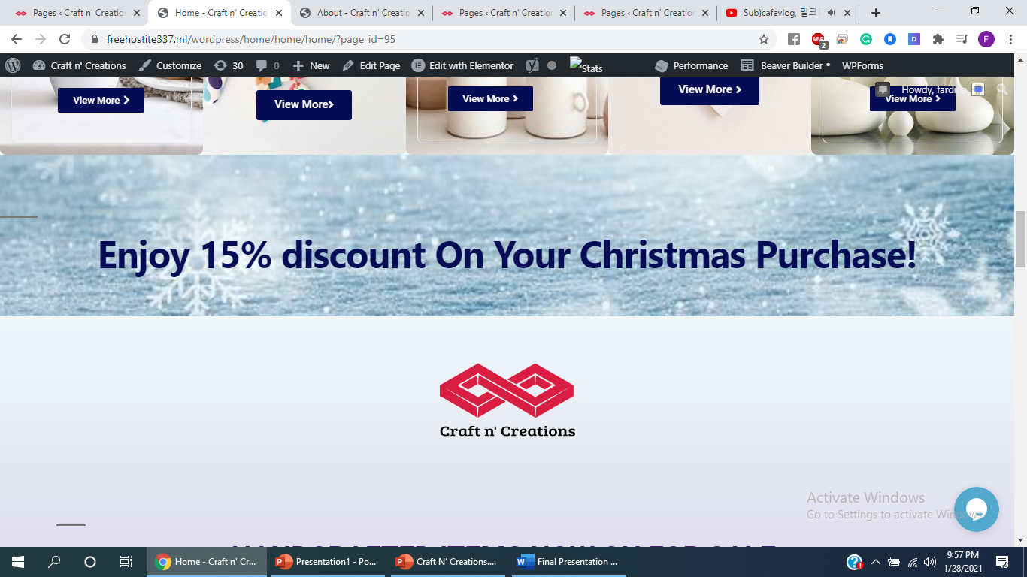
More than five different kind of post blocks used:

Slide 8
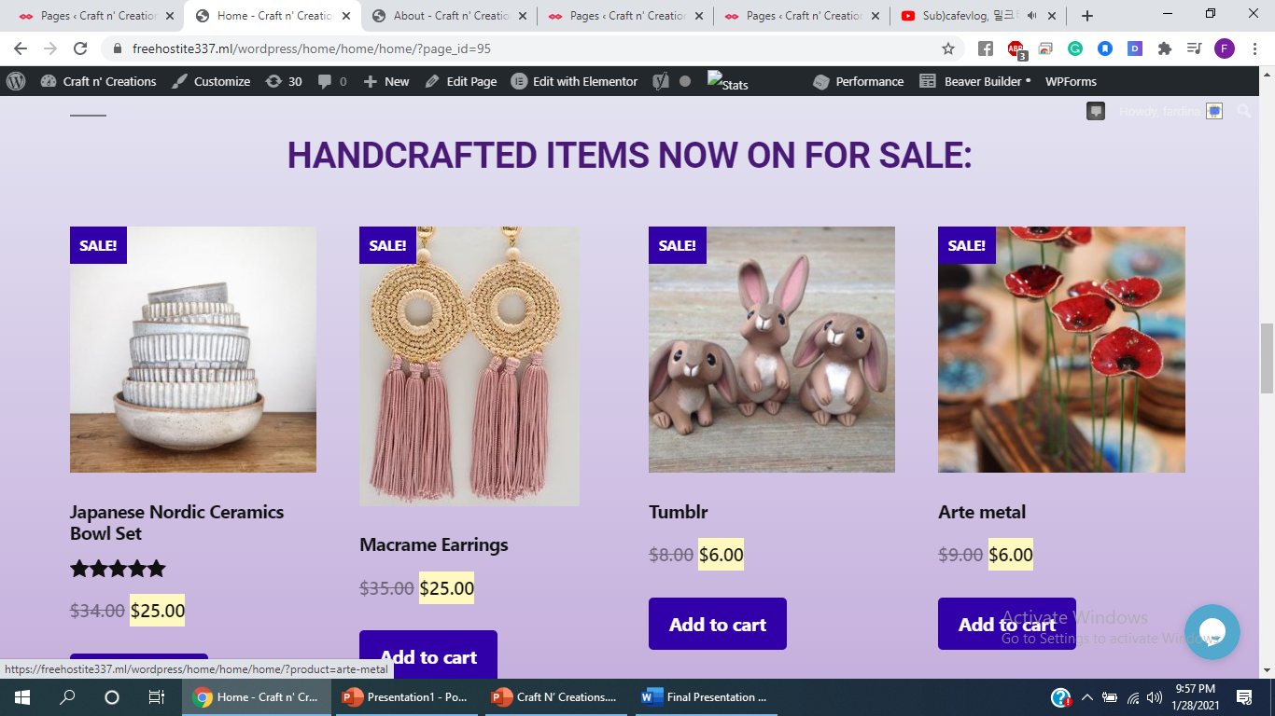
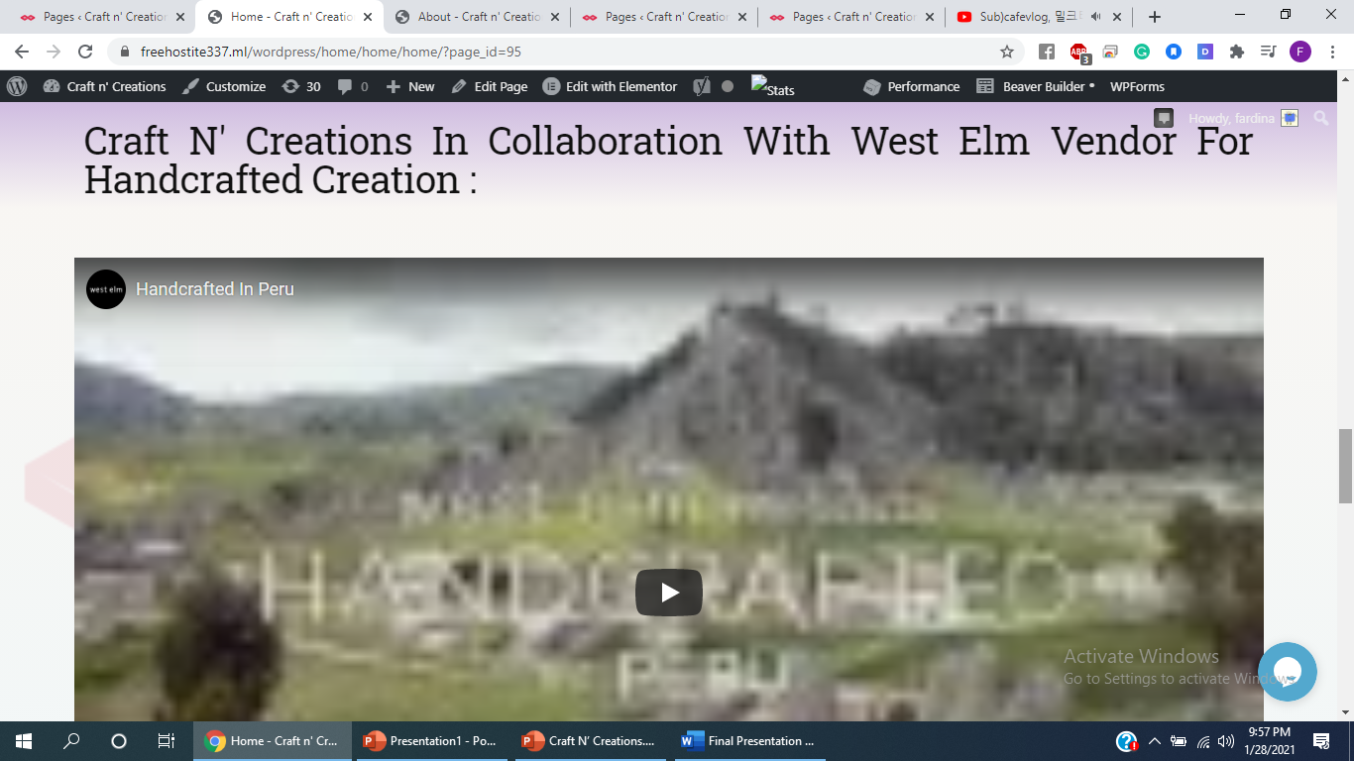
More than five different kind of post blocks used:

Slide 9
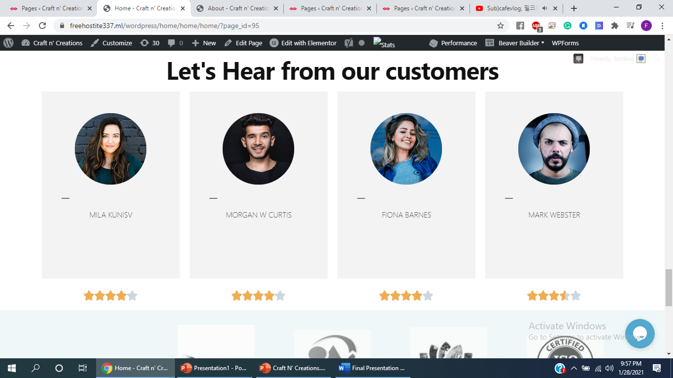
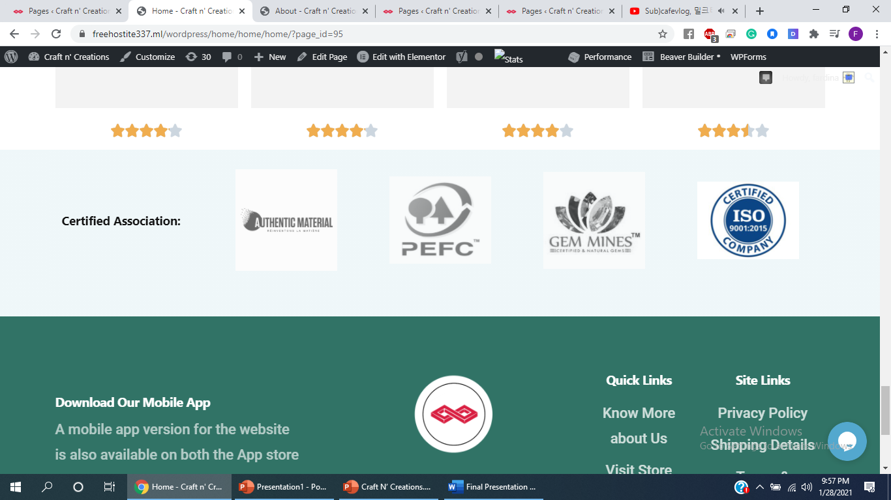
More than five different kind of post blocks used:

Slide 10
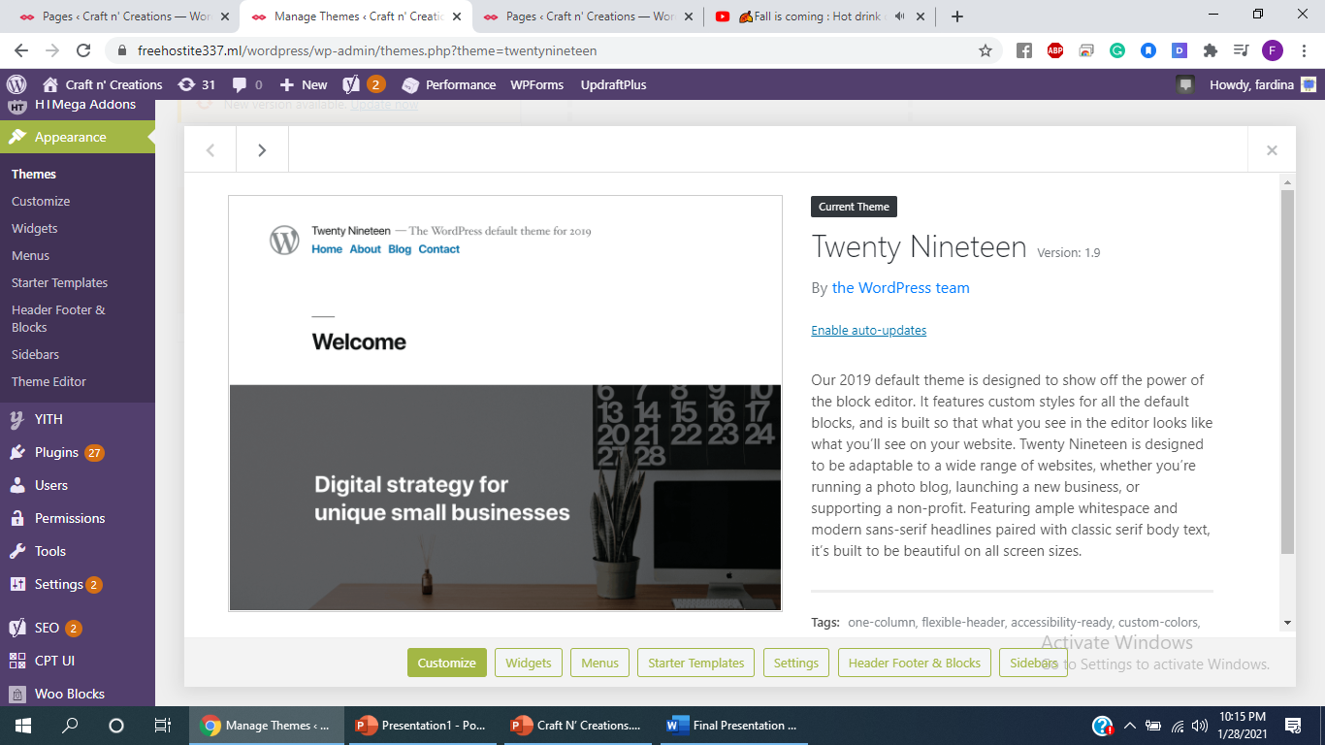
Application of Twenty-Nineteen Theme

Slide 11
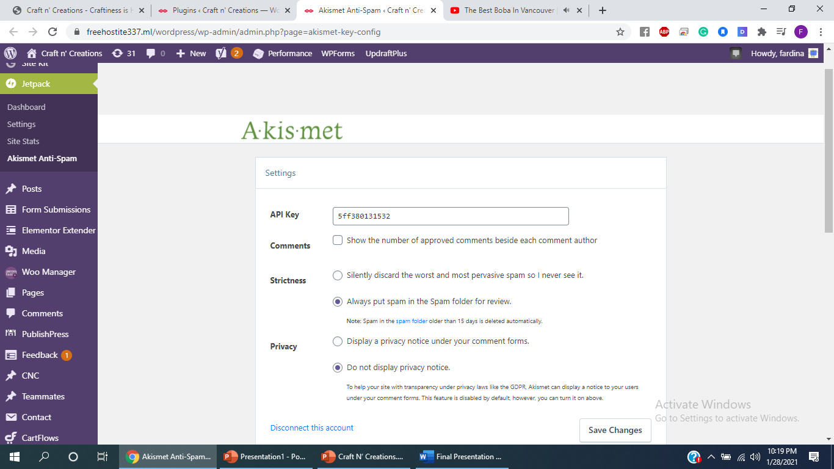
Anti-spam and security mechanisms via use of anti-spam plugin (e.g., Akismet)

Slide 12
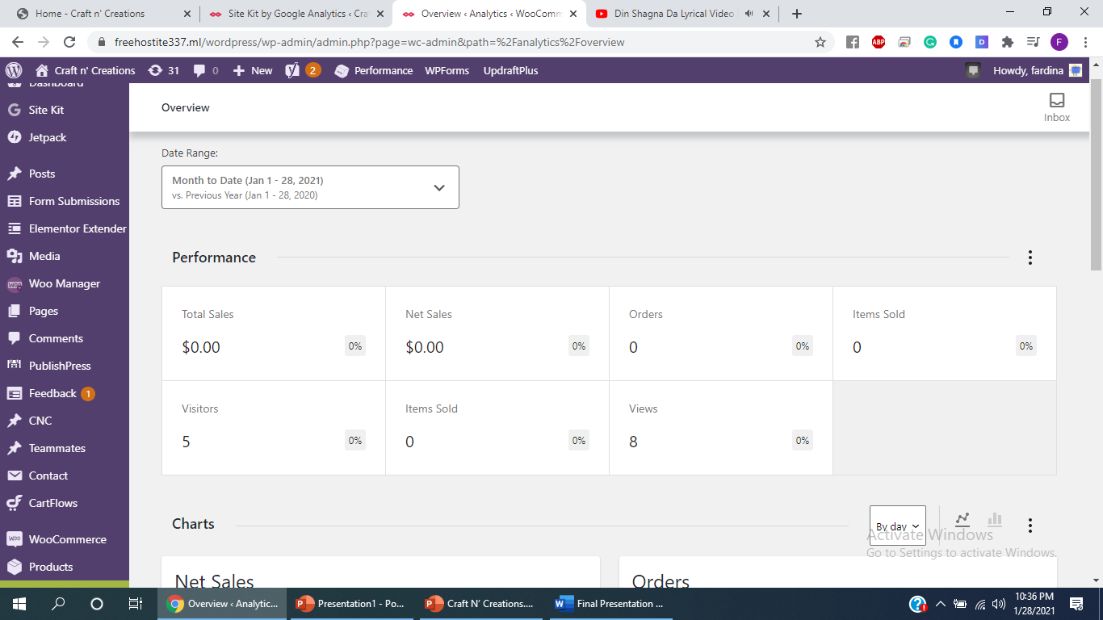
Analytic mechanisms via use of Analytic plugin i.e Google plugin

Slide 13
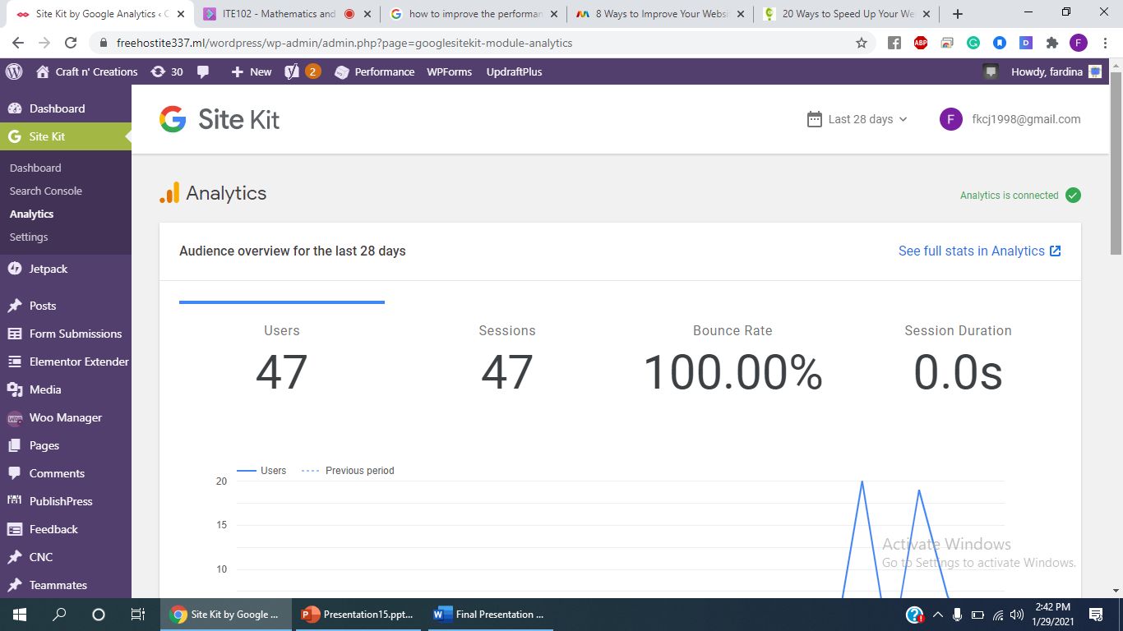
Analytic mechanisms via use of Analytic plugin i.e Google plugin.

Slide 14
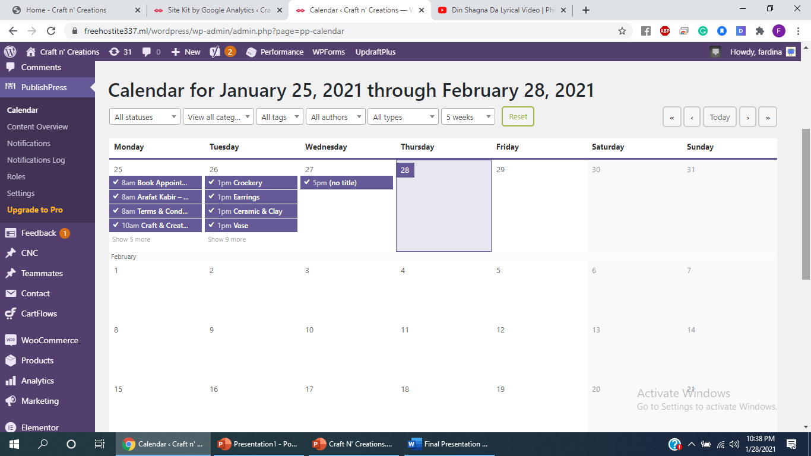
Use PublishPress plugin for editorial workflow support of multiple authors:

Slide 15
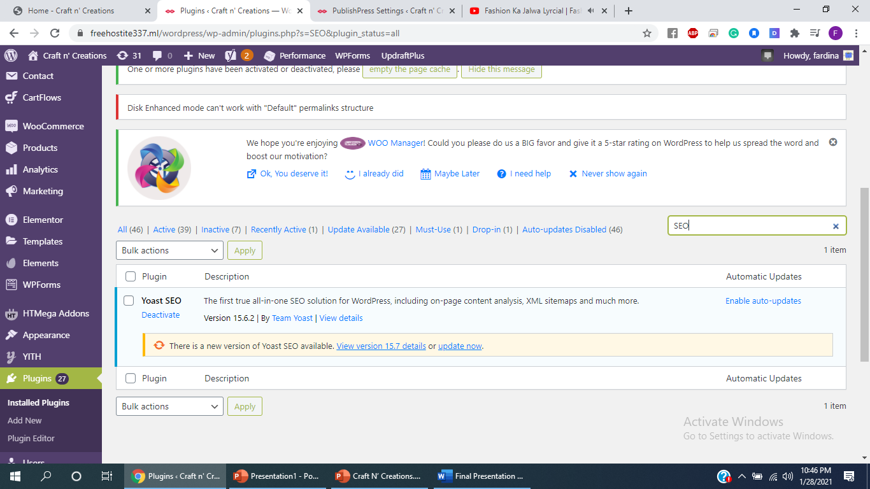
SEO mechanisms via SEO plugin (e.g., YOAST SEO)

Slide 16
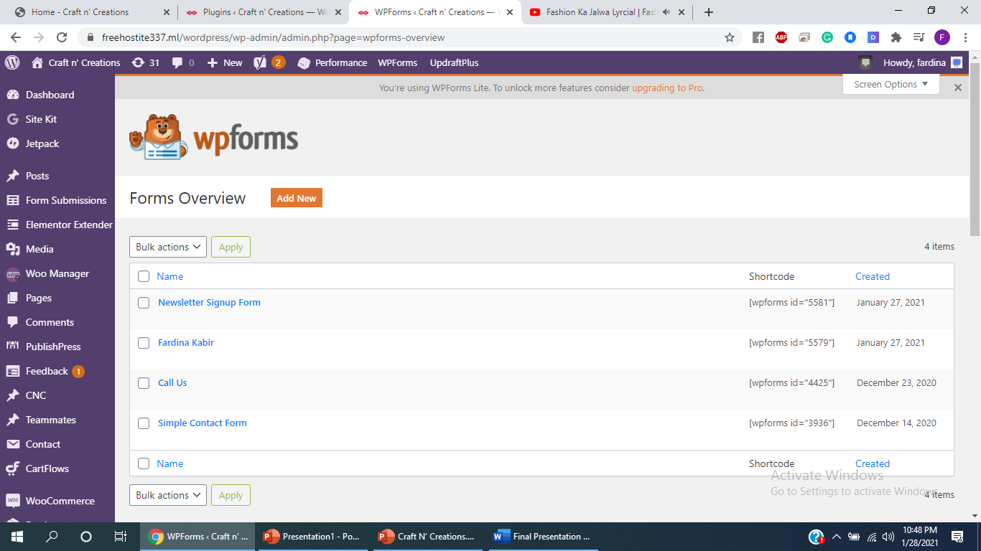
Basic form functionalities via form plugin (e.g.,WP Forms for contact and emailing)

Slide 17
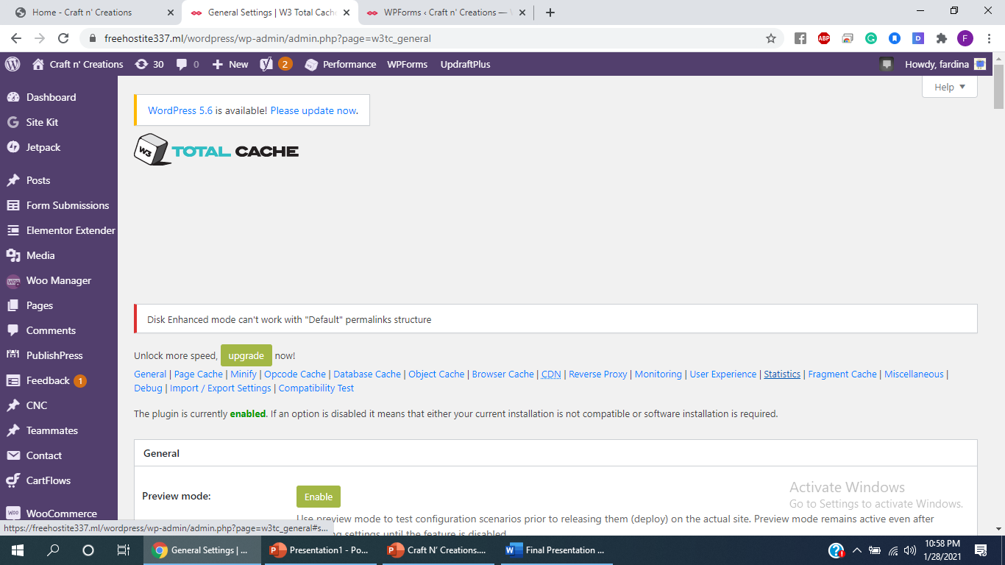
Speed up web using caching mechanisms (e.g., W3 Total Cache)

Slide 18
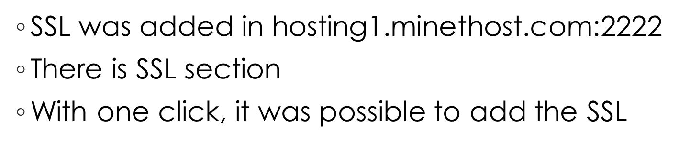
Adding SSL

Slide 19
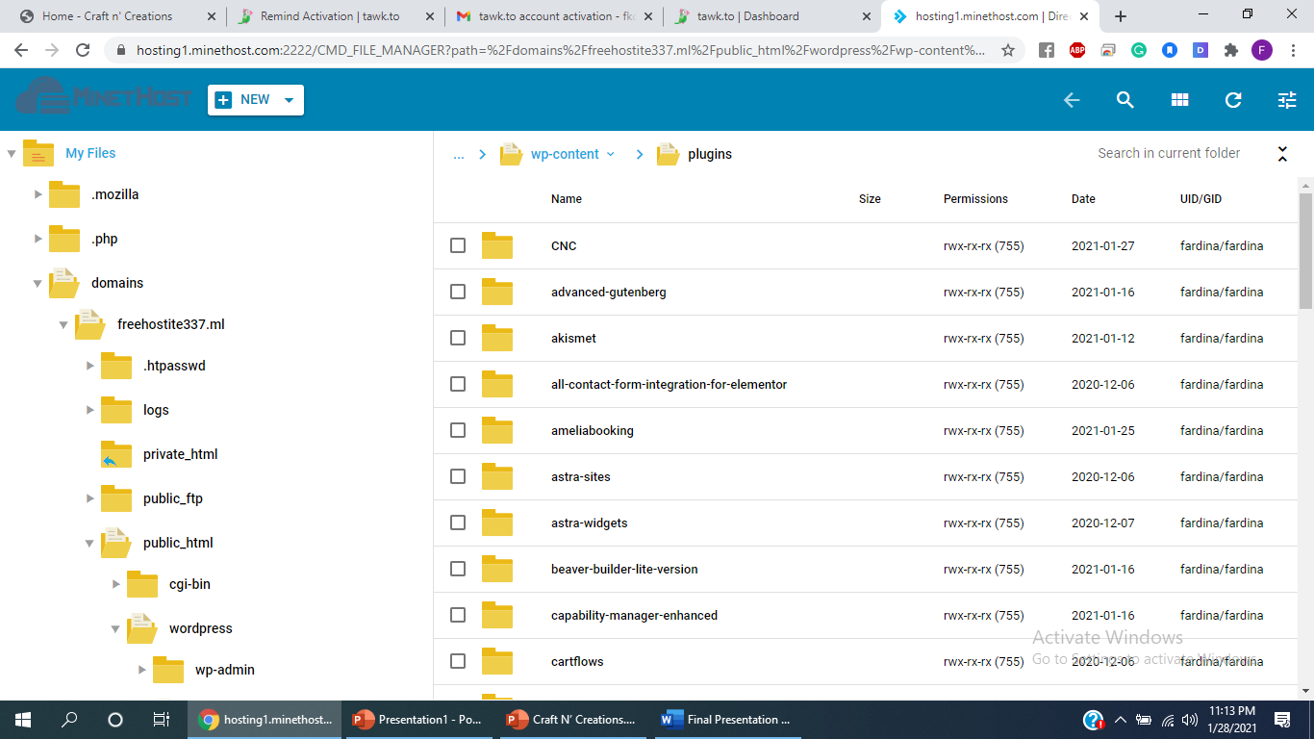
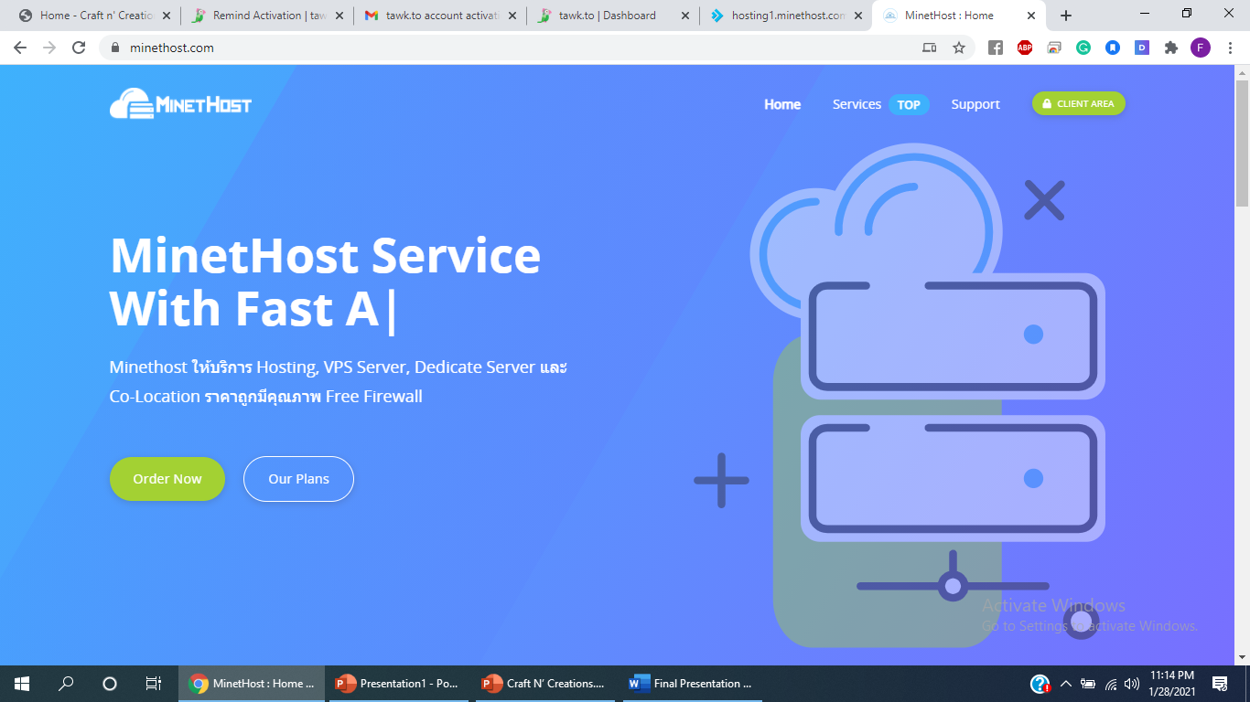
Application of Hosting is MinetHost i.e. https://minethost.com/

Slide 20
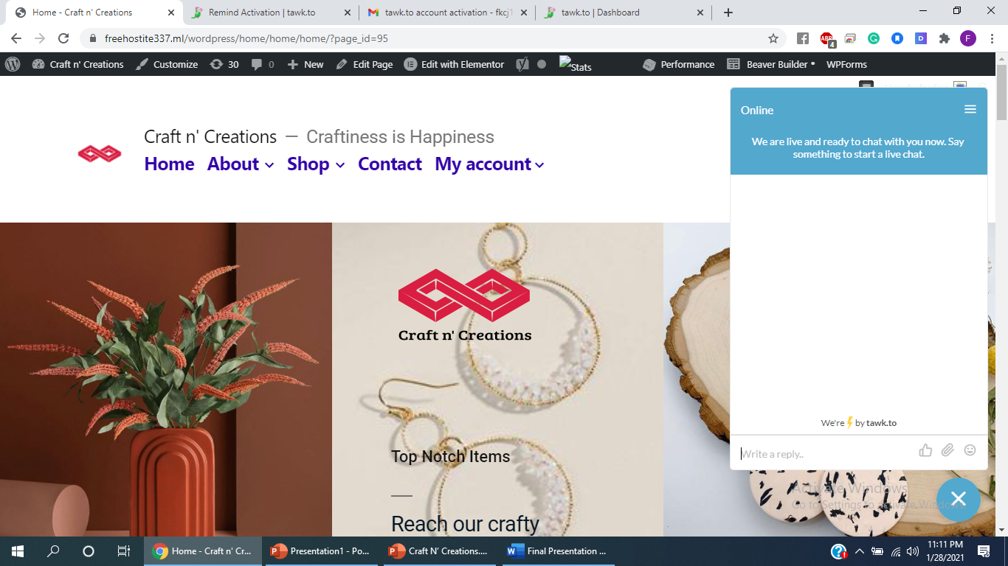
Creation of liveSupport plugin widget i.e. TAWK-TO-CHAT-WIDGET

Slide 21
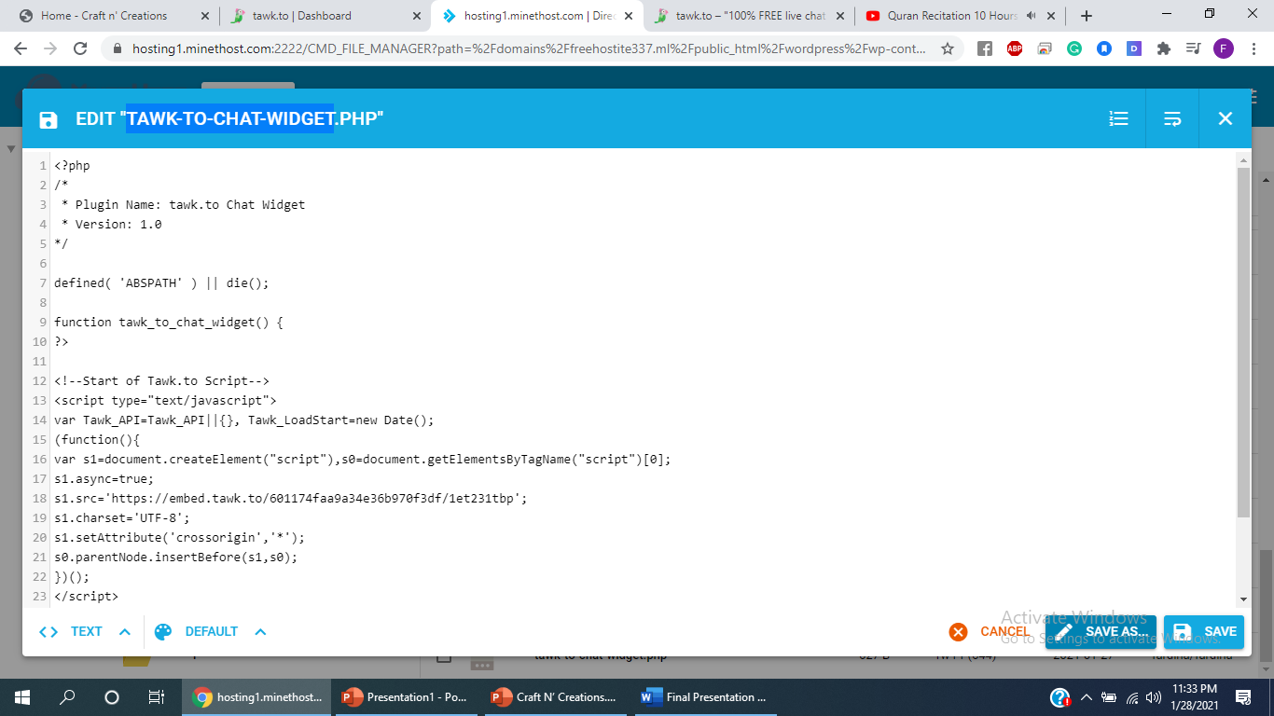
Creation of liveSupport plugin widget i.e. TAWK-TO-CHAT-WIDGET("TAWK-TO-CHAT-WIDGET.PHP“)

Slide 22
Creation of liveSupport plugin widget i.e. TAWK-TO-CHAT-WIDGET tawk.to is a free live chat app that allows monitoring and chatting with visitors on website or from a free customizable page. The widget code is received from the twak.to website as Craft & Creations site was added as the poperty for the use of the widget. The code was used with other php code for the functioning of the plugin and also the dashboard for CNC website from the tawk.to website .

Slide 23
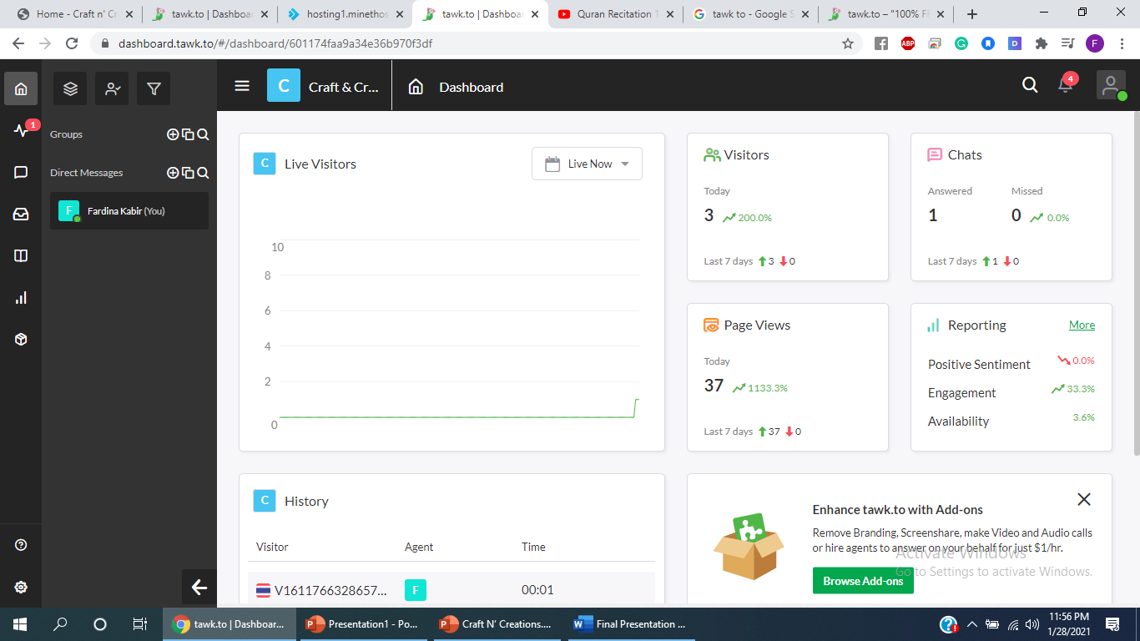
Creation of liveSupport plugin widget i.e. TAWK-TO-CHAT-WIDGET ( Dashboard from the twak.to website)

Slide 24
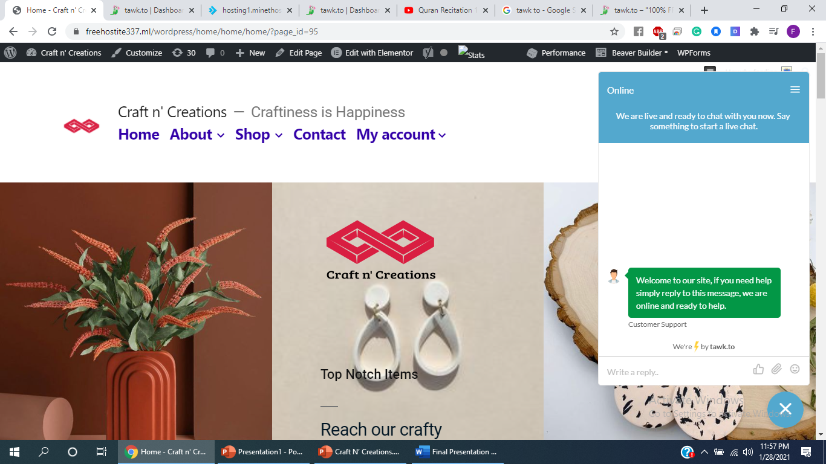
Creation of liveSupport plugin widget i.e. TAWK-TO-CHAT-WIDGET

Slide 25
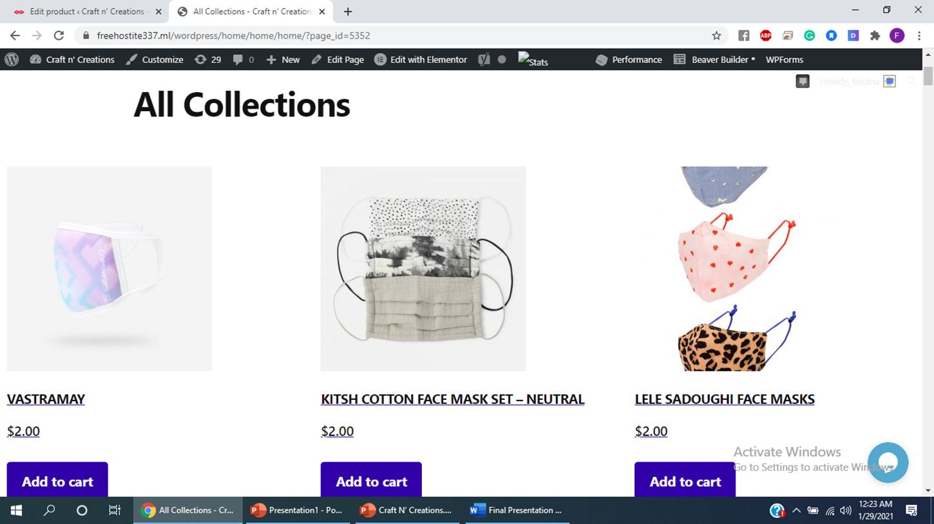
WooComerce sets up the Shop Store where products created with the help of woocommerce plugin

Slide 26
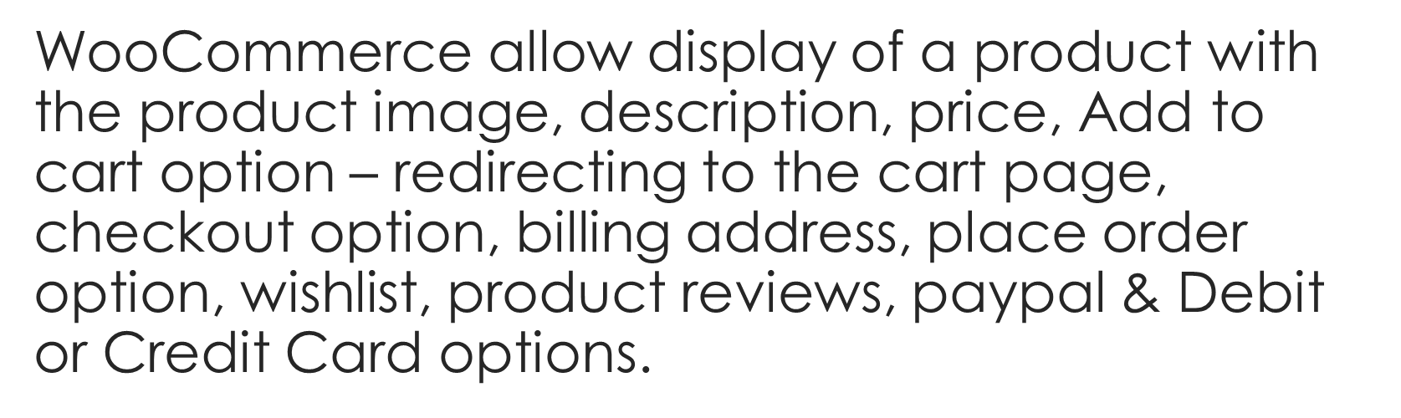
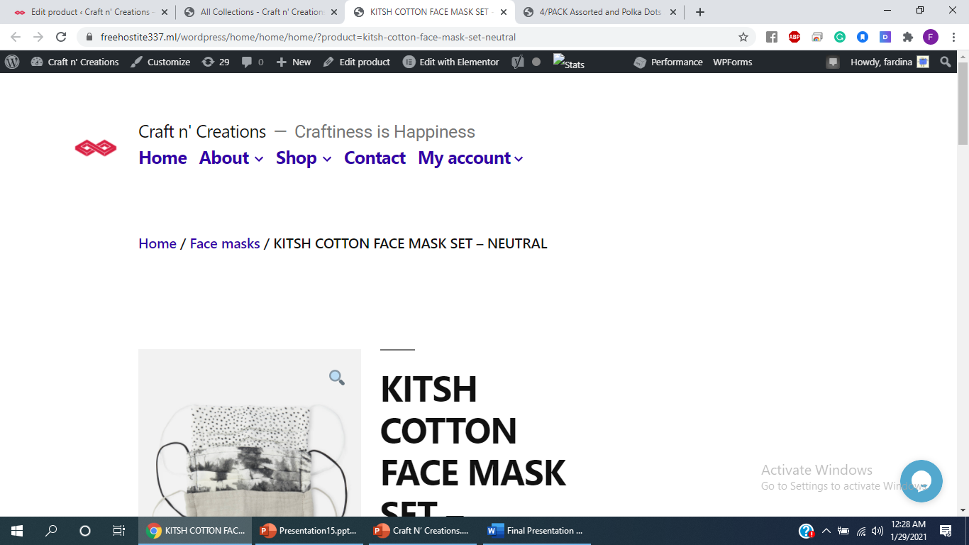
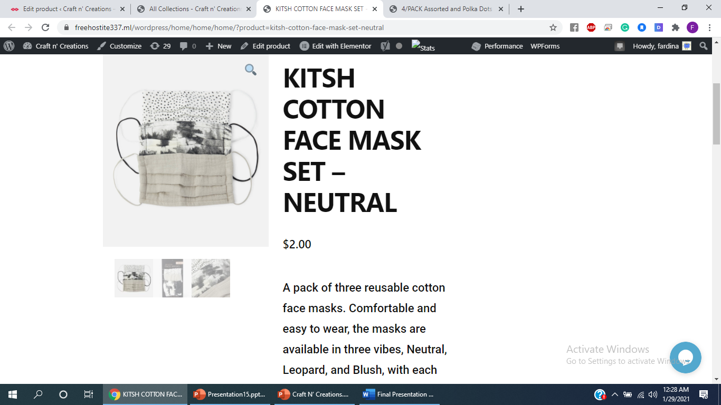

Slide 27
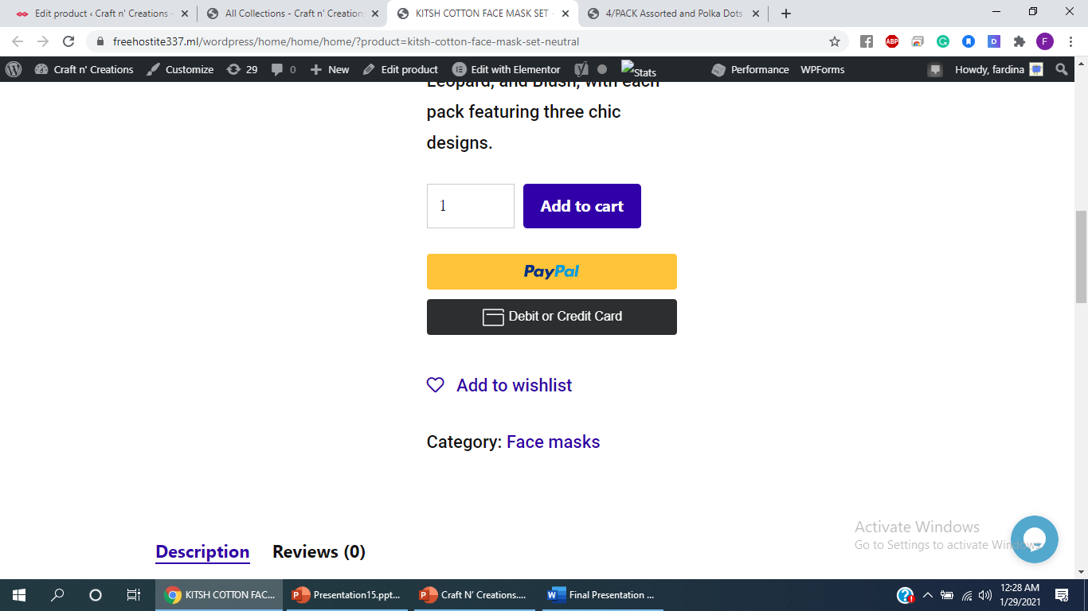
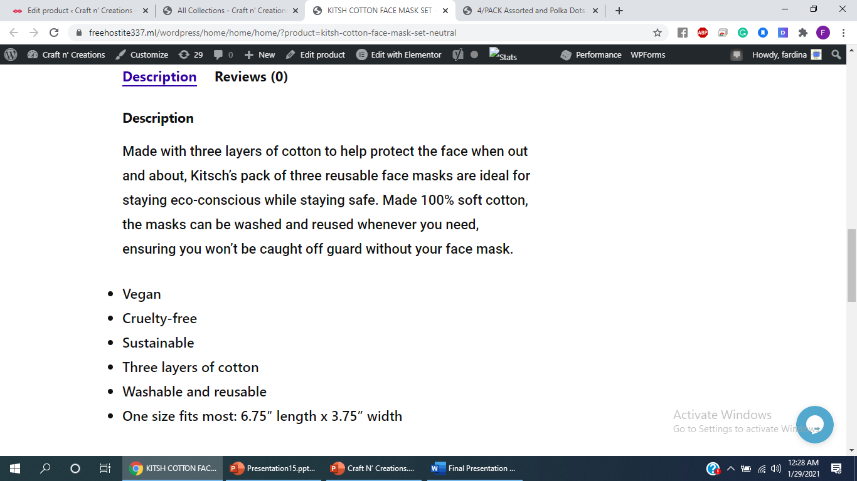
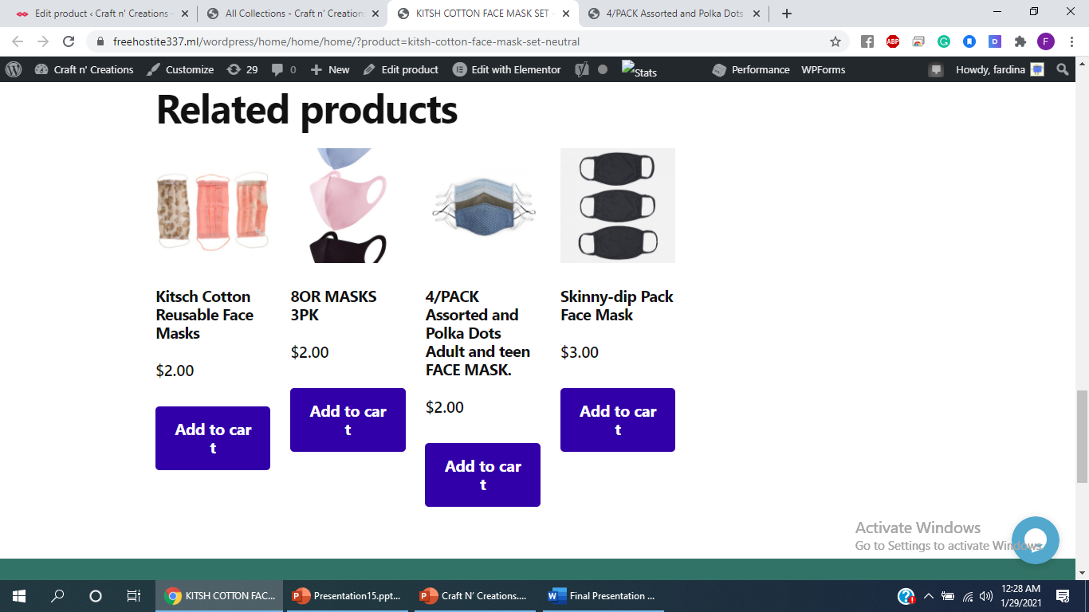

Slide 28
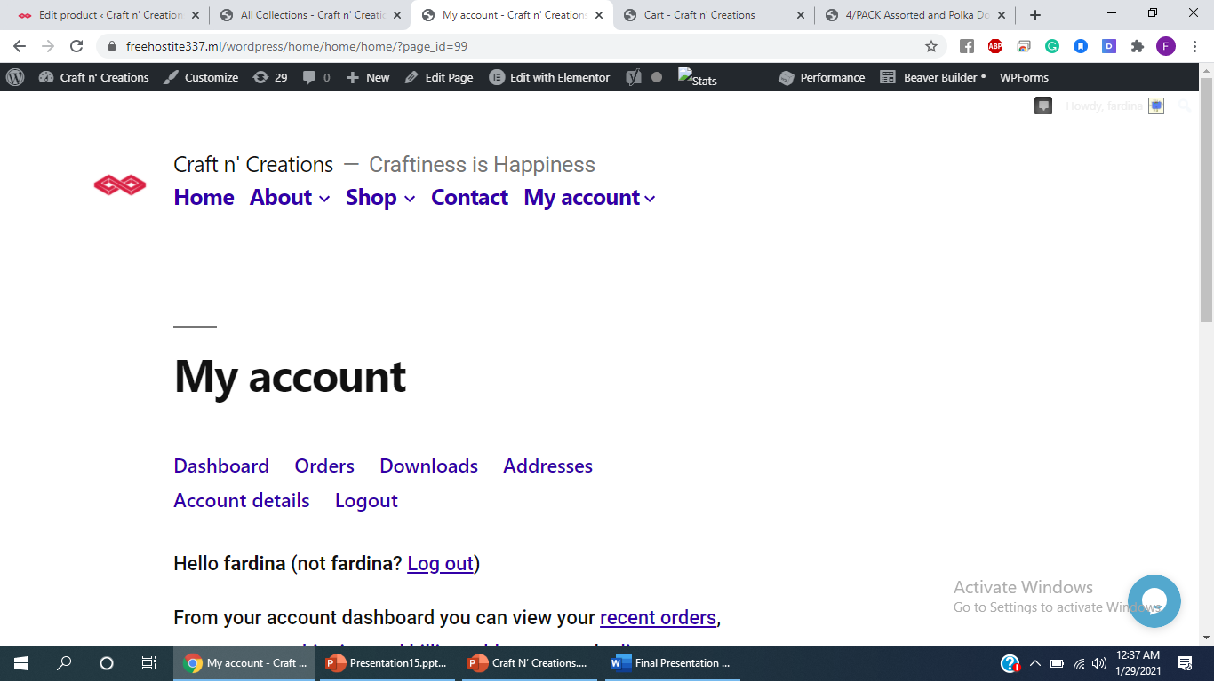
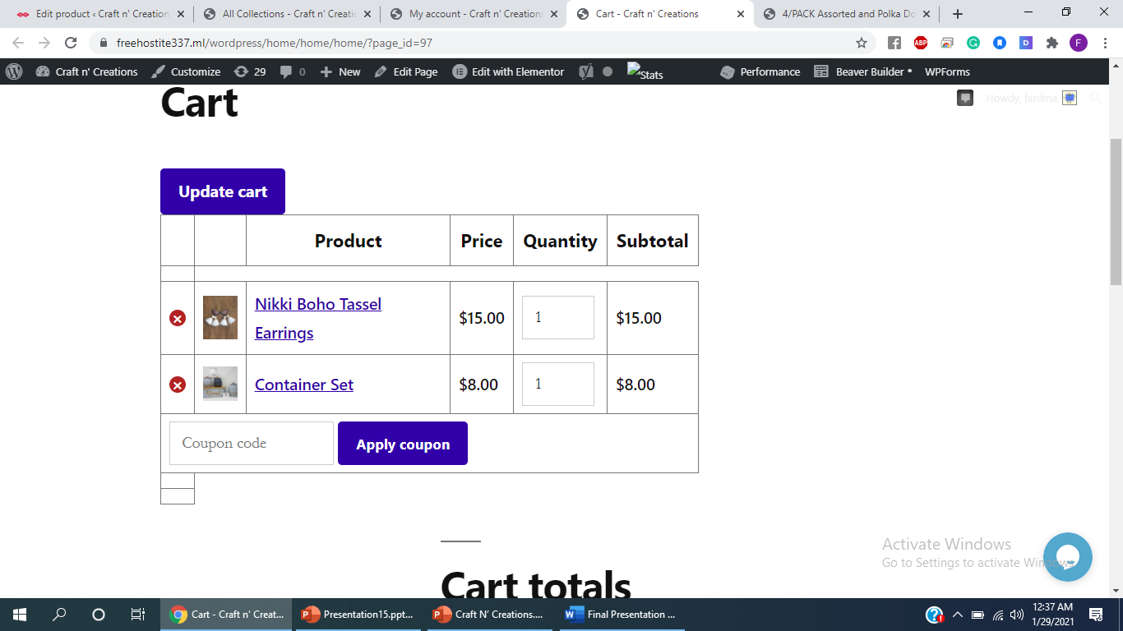
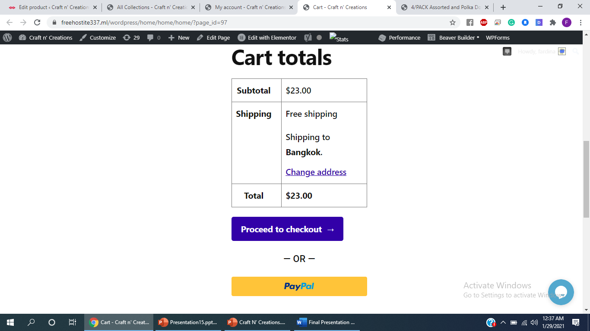
Management of my account, cart & wishlist with WooCommerce

Slide 29
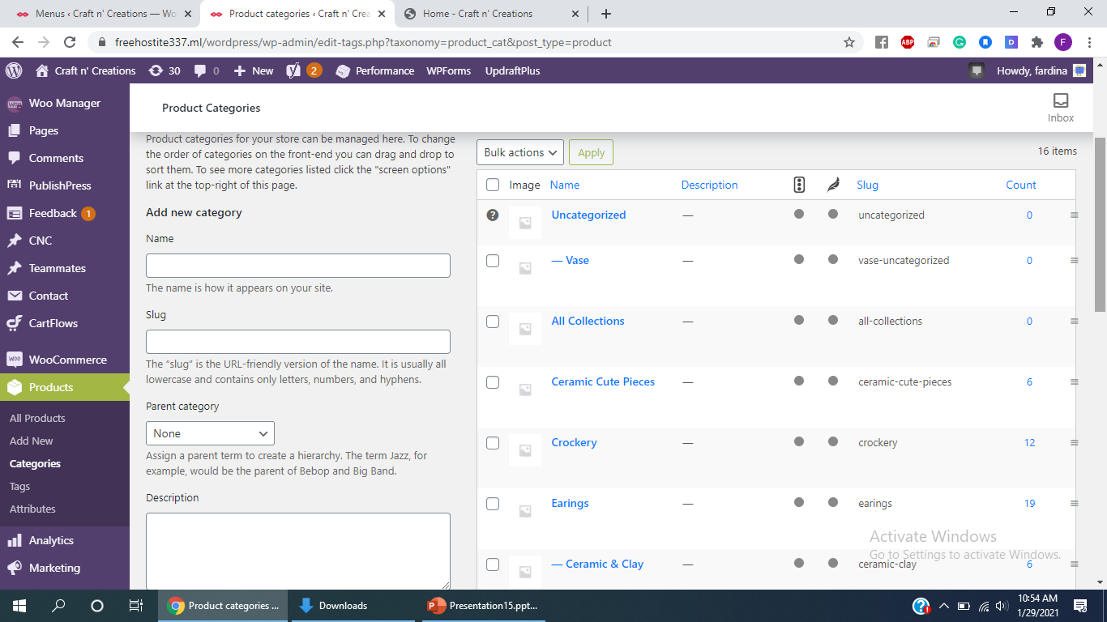
Product Categories

Slide 30
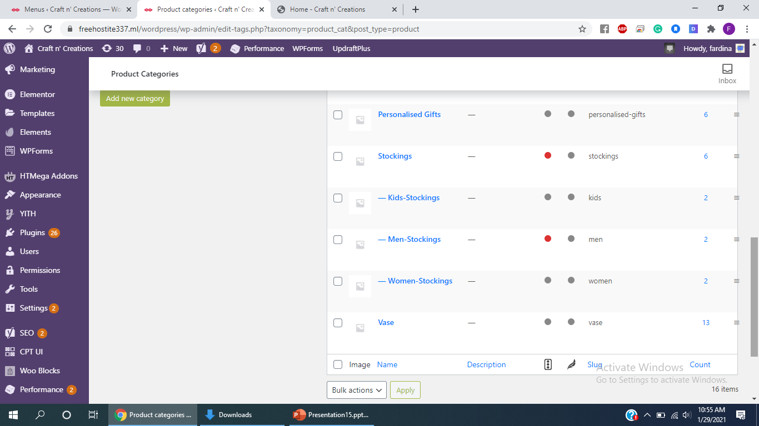
Product Categories

Slide 31
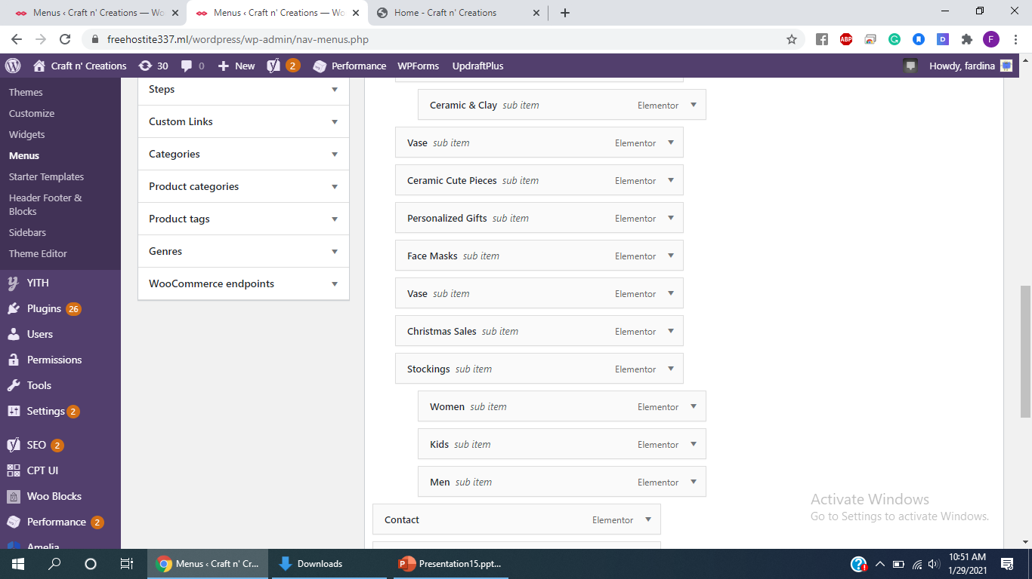
Menus

Slide 32
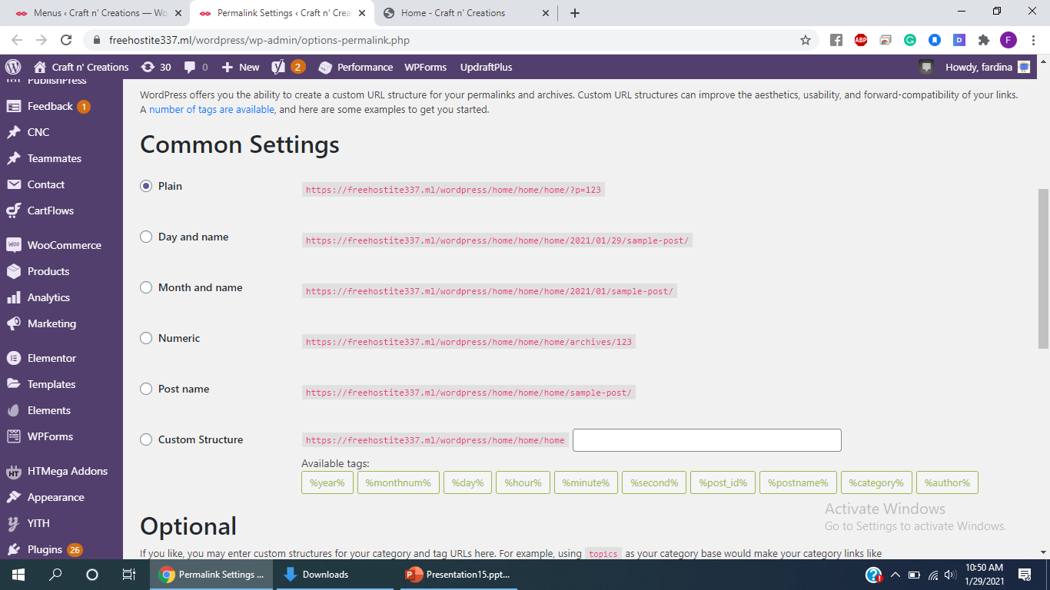
Permalink Settings

Slide 33
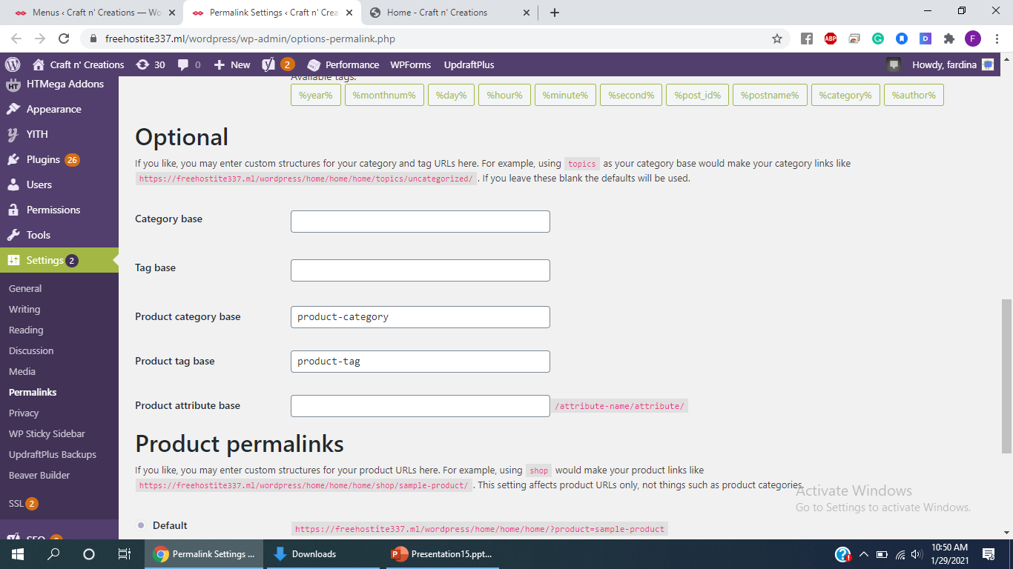
Permalink Settings

Slide 34
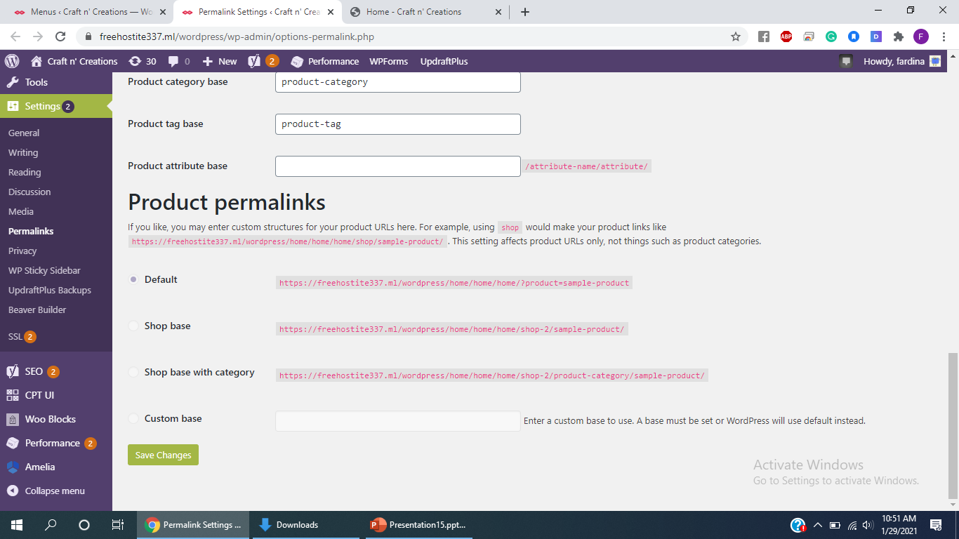
Permalink Settings

Slide 35
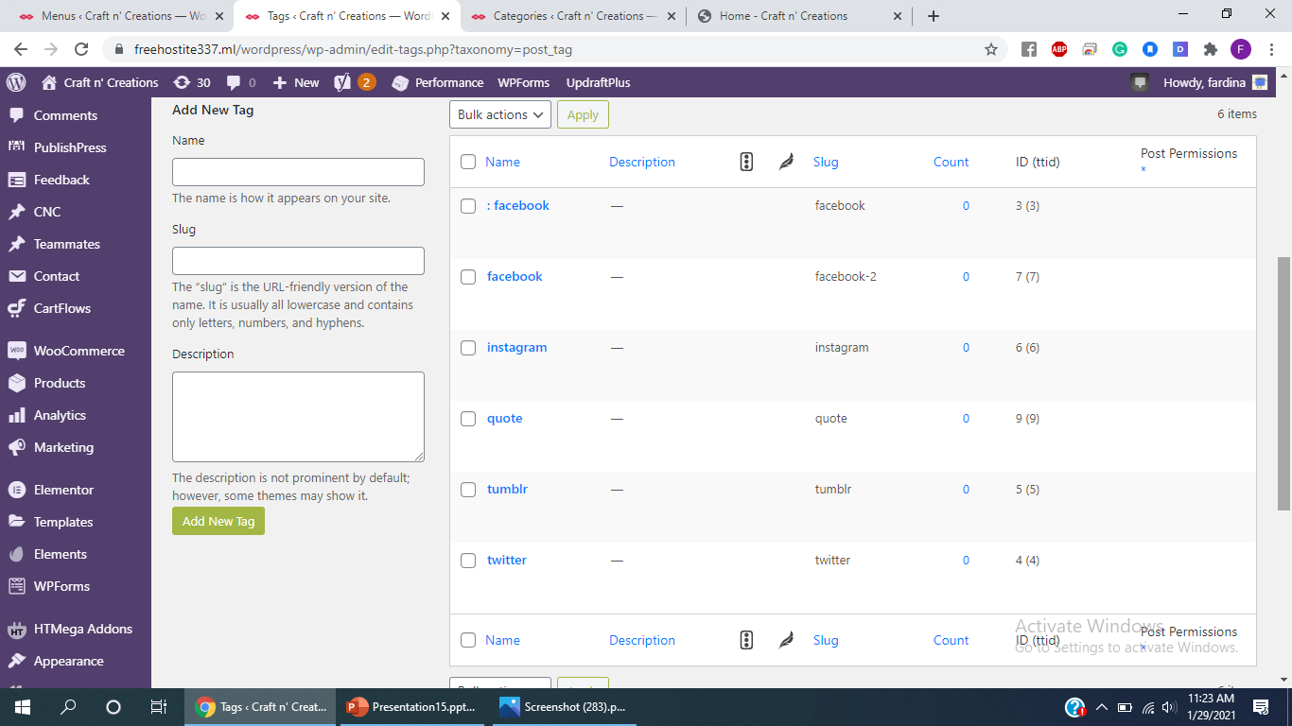
Tags

Slide 36
Changes from Midterm
Addition of wide variety of products. i.e. Christmas Sales, Face Masks, Personalised Gifts, Stockings, Ceramic cute pieces, Earrings, Ceramic & Clay Earrings, vase & crockery. Overall 74 products created, each with price tag, description, product image & related products image gallery , product category and product heading name.
Plugins used after mid-term: really simple ssl, publishpress,akismet, Google Analytics, Yoast Seo, woocommerce, elementor, wpforms , Jetpack, Health Check & Troubleshooting, W3 total cache& Sitekit by Google.
Creation of live support chat plugin i.e.twak.to widget.
Creation of pages such as Why Us, all pages in the shop category e.g all collections, crockery, earrings, vase, etc.
Addition of categories, pages and custom link to the menus.
Full width display pages for the display of products in the shop store.
. Creation of pages such as shipping details, privacy & policy and Terms & Conditions for adding site links to the footer options.

Slide 37
Thank You

